Slide 1

Danish Cardiac Arrest Registry 2023
Executive Summary of the annual report 2023
In 2001, the Danish Cardiac Arrest Registry began collecting data on out-of-hospital cardiac arrests (OHCA) in Denmark. Data was initially registered manually but in 2016 an electronic form of registration was implemented. After a process of thorough high quality data validation in the five Danish EMS organisations the electronic registration has led to a more complete set of data with approximately 5,000 OHCA registered annually.
Denmark has seen a positive development during the 20 years of the registry with both bystander CPR and survival rates quadrupled.
The survival rate of 14 % amounts to 644 persons or 11 persons per 100,000 persons in population.
Within recent years, an increasing percentage of OHCA patients in private residences are defibrilated by an AED before EMS arrival.

Slide 2
Remarkable results from the Danish Cardiac Arrest Registry 2023
Approximately 5,000 OHCA per year
Very high bystander CPR rate: 76 %
High survival rates:
ROSC (incl. EMS) 27 % on arrival to hospital
30 days survival all: 14 % including all OHCA
30 days survival Utstein benchmark (shockable, witnessed) 45 %
30 days survival or lives saved: 644 = 11 per 100,000 in population
AED defibrilation by bystanders 23 % of OHCA in public places
Return to work 76 %
Kragholm K, Wissenberg M, Mortensen RN, Fonager K, Jensen SE, Rajan S, m.fl. Return to Work in Out-of-Hospital Cardiac Arrest Survivors
CLINICAL PERSPECTIVE: A Nationwide Register-Based Follow-Up Study. Circulation. 12. maj 2015;131(19):1682–90.

Slide 3
Guide to figures and tables
The figures in this Executive Summary are composed
with the following composition of colours:
Cardiac Arrest and survival Red
Bystander intervention Blue
AED intervention Green
Figures are mainly composed with Actual Numbers on the right y-axis and percentage or numbers by 100,000 population on the left y-axis.
Absolute Numbers are shown as coloured columns and percentage by lines.

Slide 4
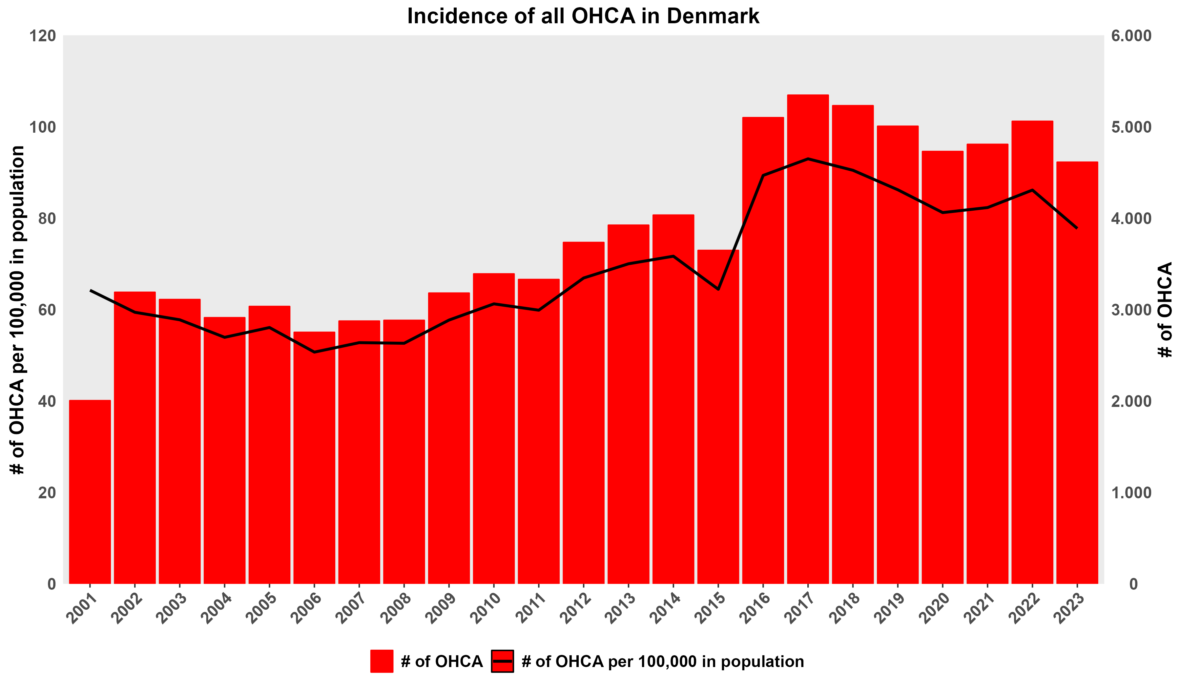

Slide 5
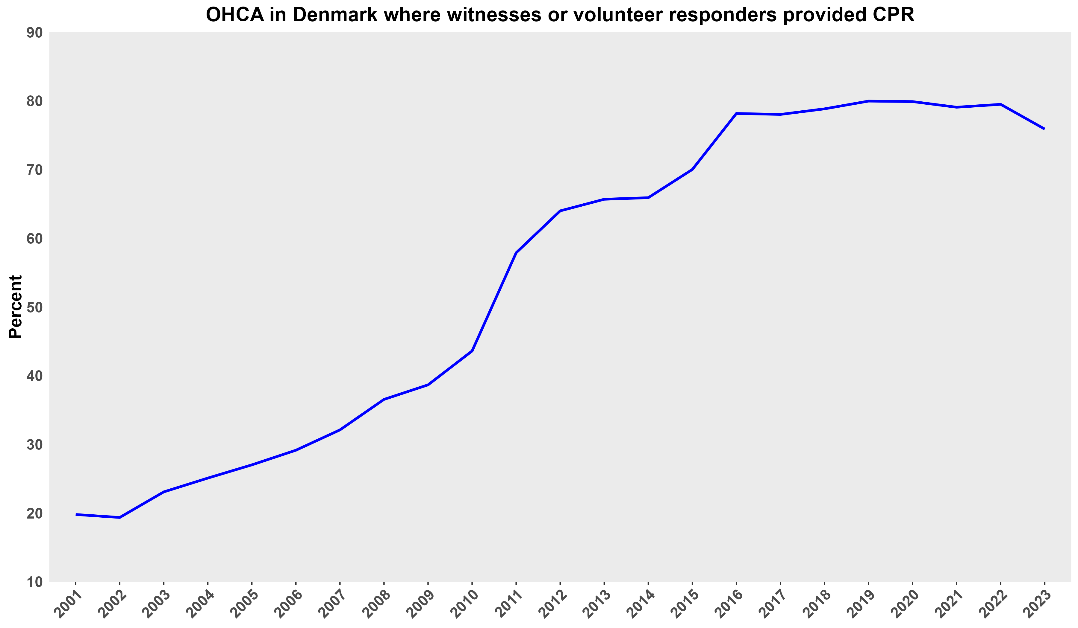

Slide 6
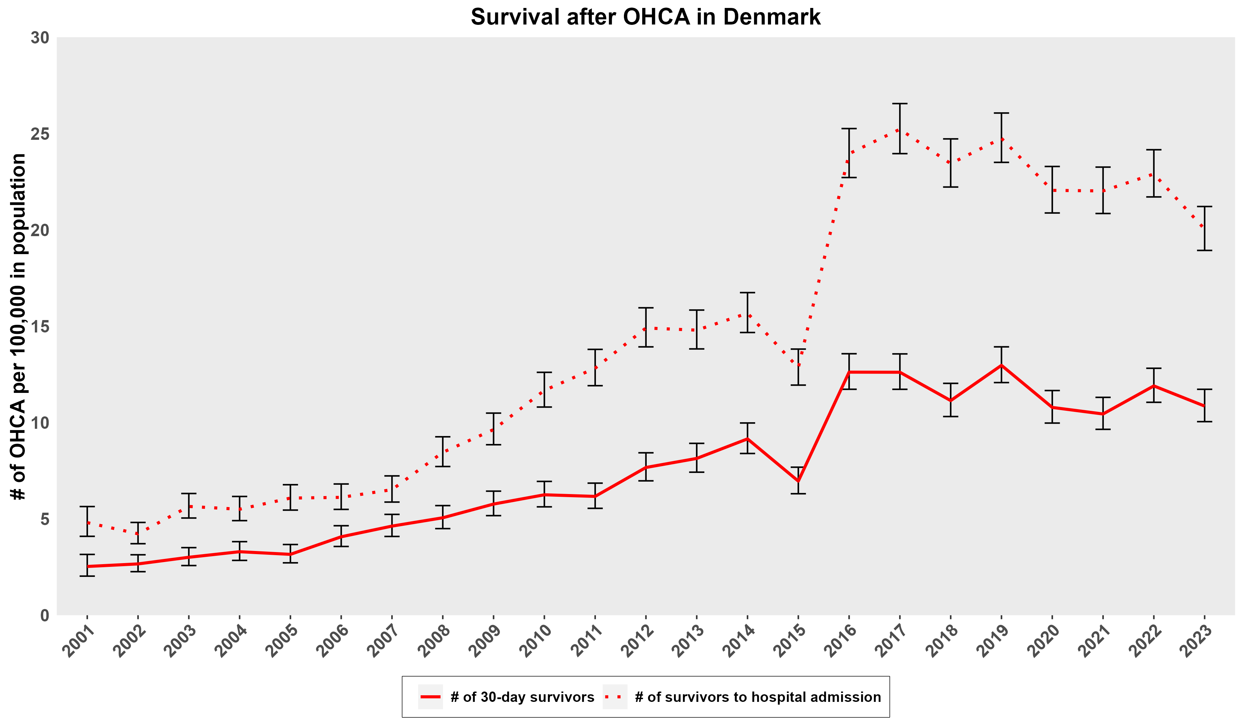

Slide 7
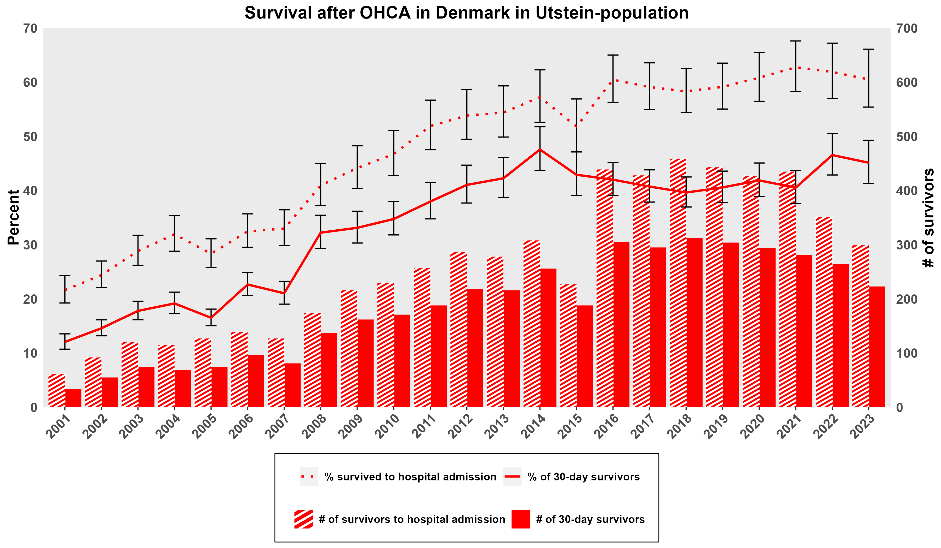

Slide 8
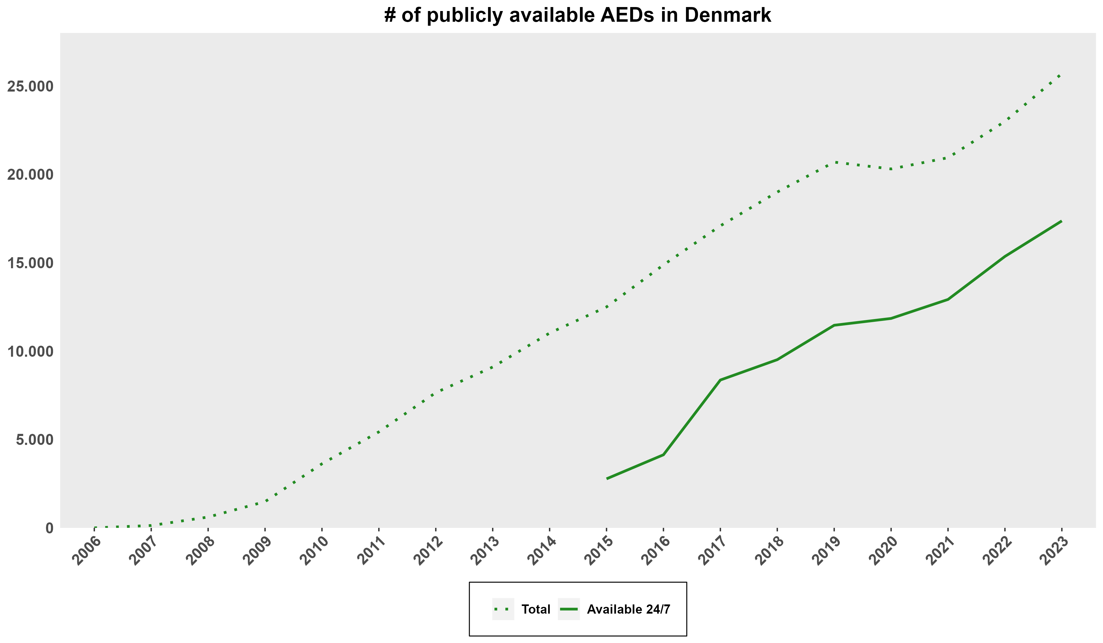

Slide 9
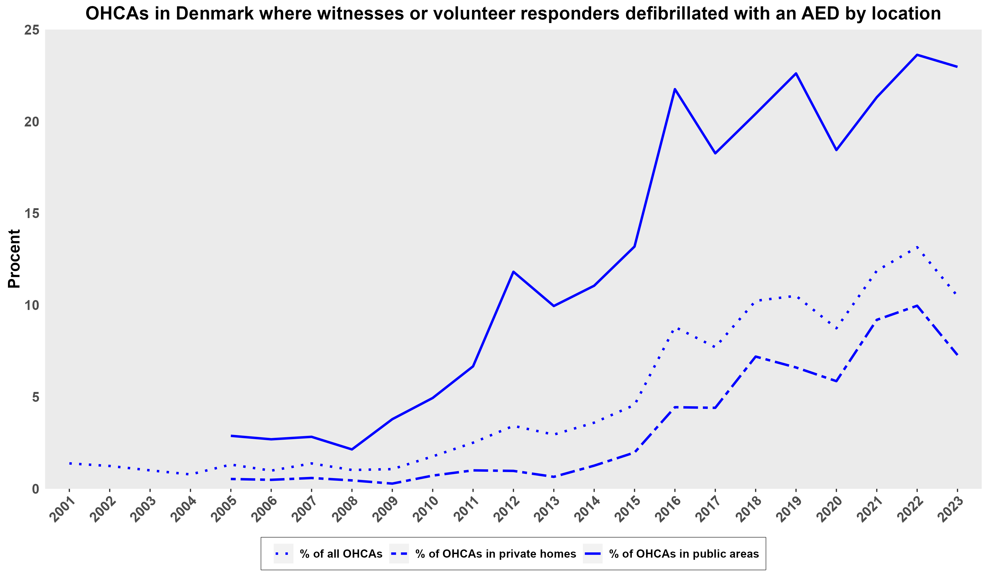

Slide 10
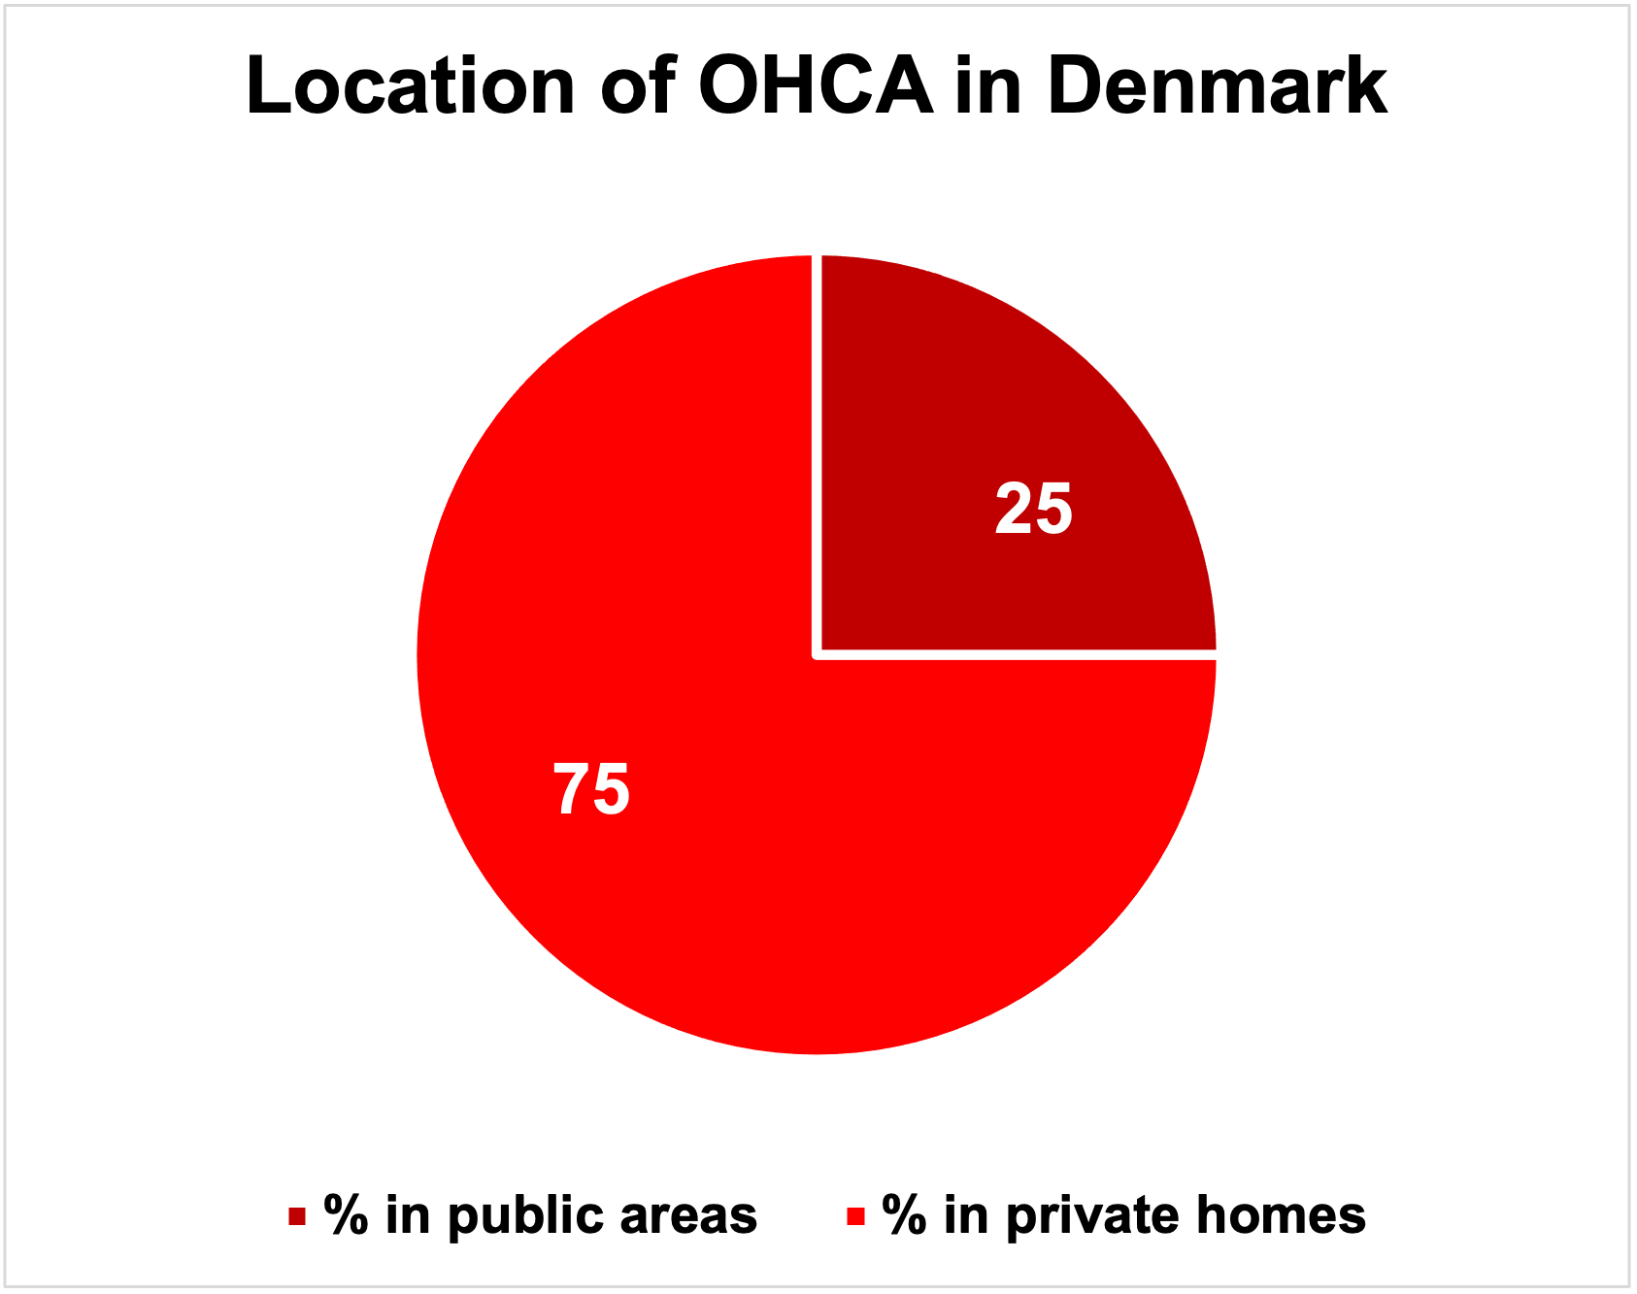
Danish Out-of-Hospital Cardiac Arrest Registry, https://hjertestopregister.dk

Slide 11


The Danish Cardiac Arrest Registry
Danish Resuscitation Council
www.genoplivning.dk
Global Resuscitation Alliance
www.globalresuscitationalliance.org
Resuscitation Academy
www.resuscitationacademy.org

